Slide 1
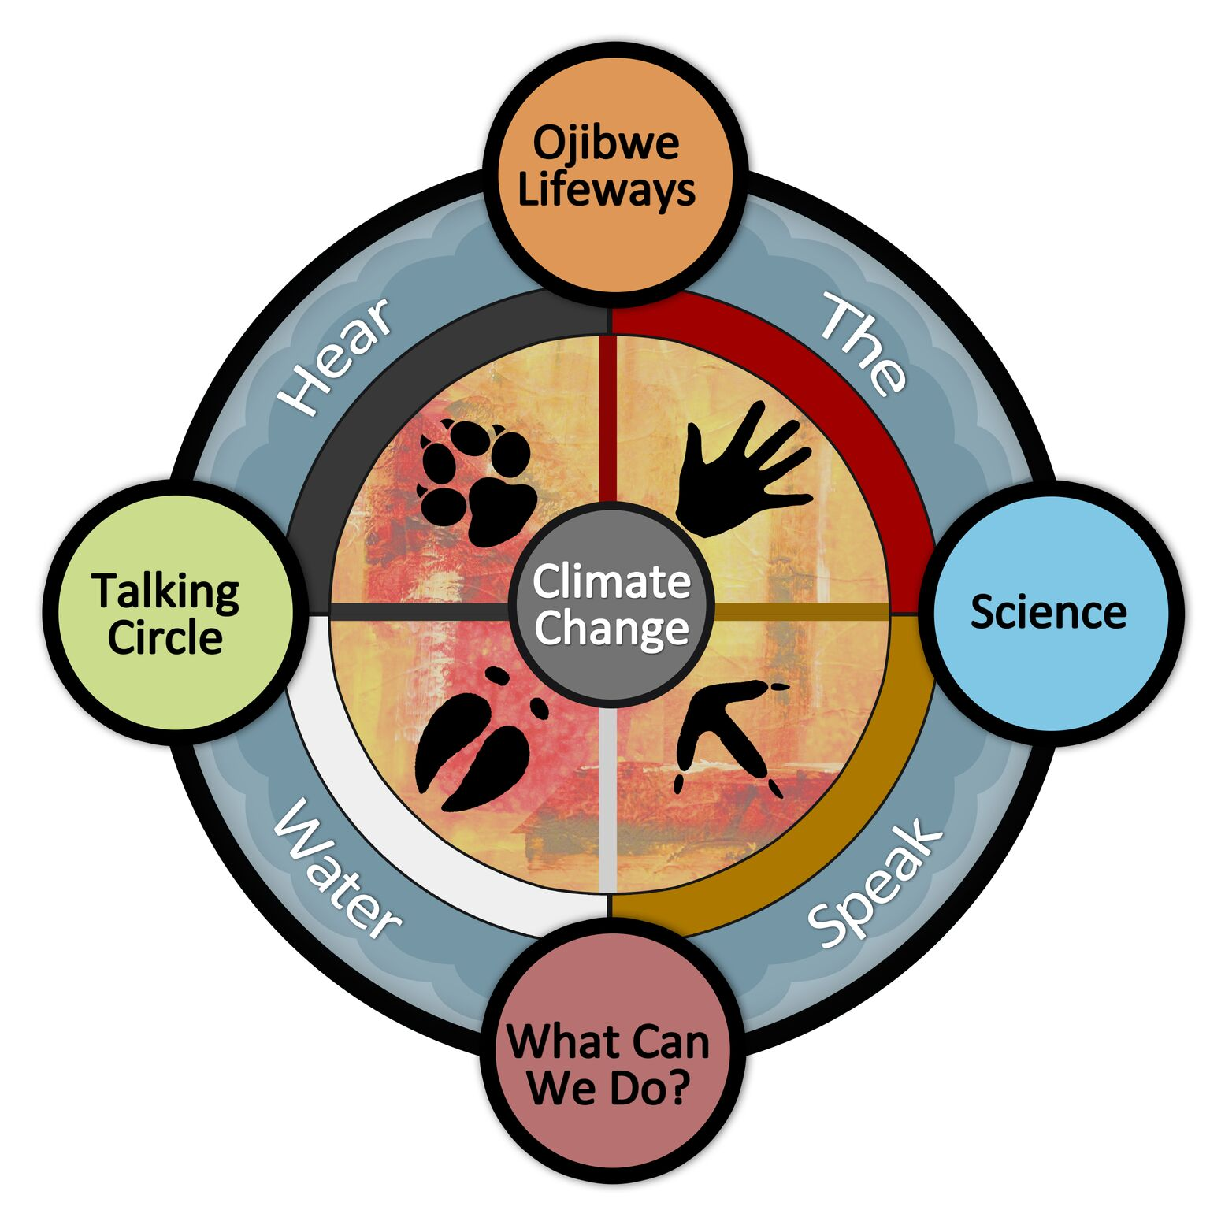
Using the Gikinoo’wizhiwe Onji Waaban (Guiding for Tomorrow) or
“G-WOW” Model to Build Climate Awareness & Action
Cathy “Cat” Techtmann- Environmental Outreach State Specialist
Professor, Community Resource Development
University of Wisconsin Madison-Division of Extension
Iron County, WI

Slide 2
The G-WOW Model is a methodology for integrating indigenous Traditional Ecological Knowledge (TEK), place-based knowledge, and scientific ecological knowledge (SEK) to increase climate awareness
for people of all cultures and location
to promote climate action.

Slide 3
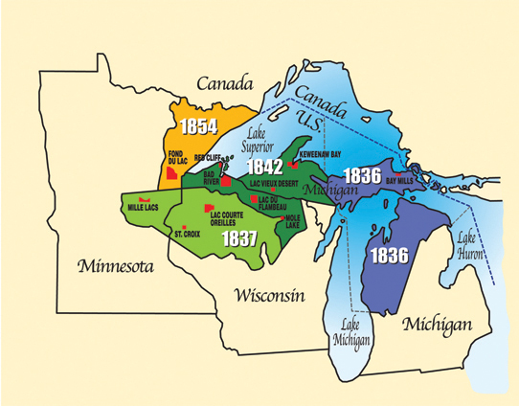
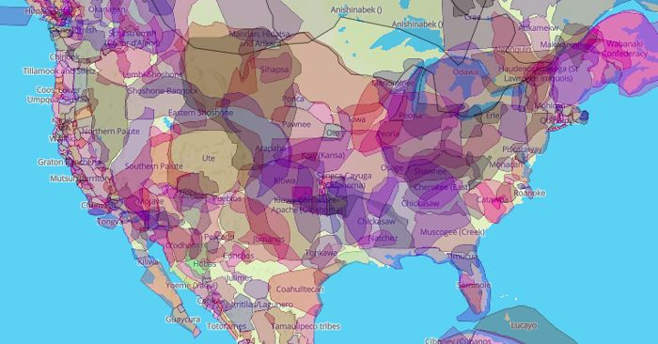
We all are on Native land…
The G-WOW Model was developed in the Lake Superior Ojibwe Indian Country
but is applicable in other locations and cultures

Slide 4
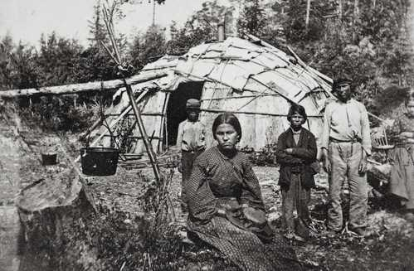
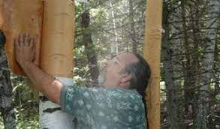
For centuries, the Ojibwe people have lived here. They have an active relationship with this land and the plant and animal beings living here.
The land, water, plants, and animals are considered relatives, not resources. This relationship is based on respect and equitable co-existence.
Photo: Northland College

Slide 5
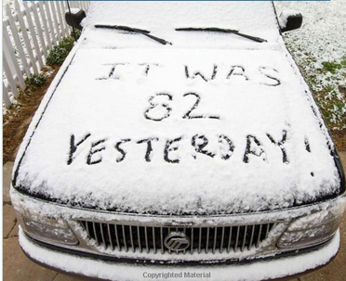
What Knowledge Can We Use to Provide Evidence of
Climate Change?

Slide 6
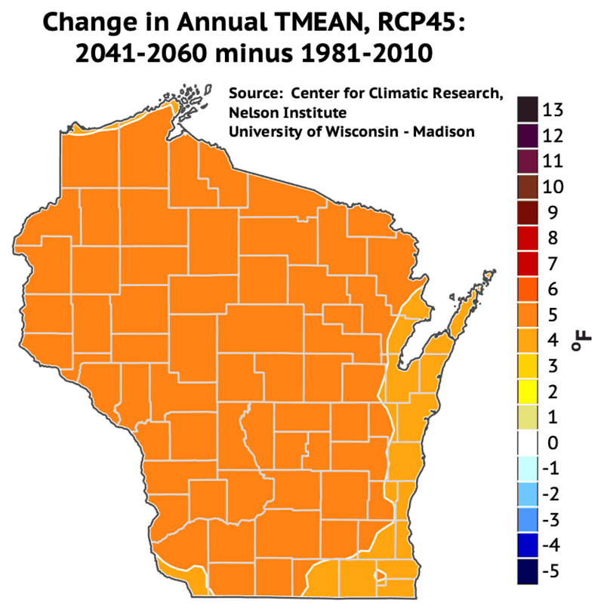
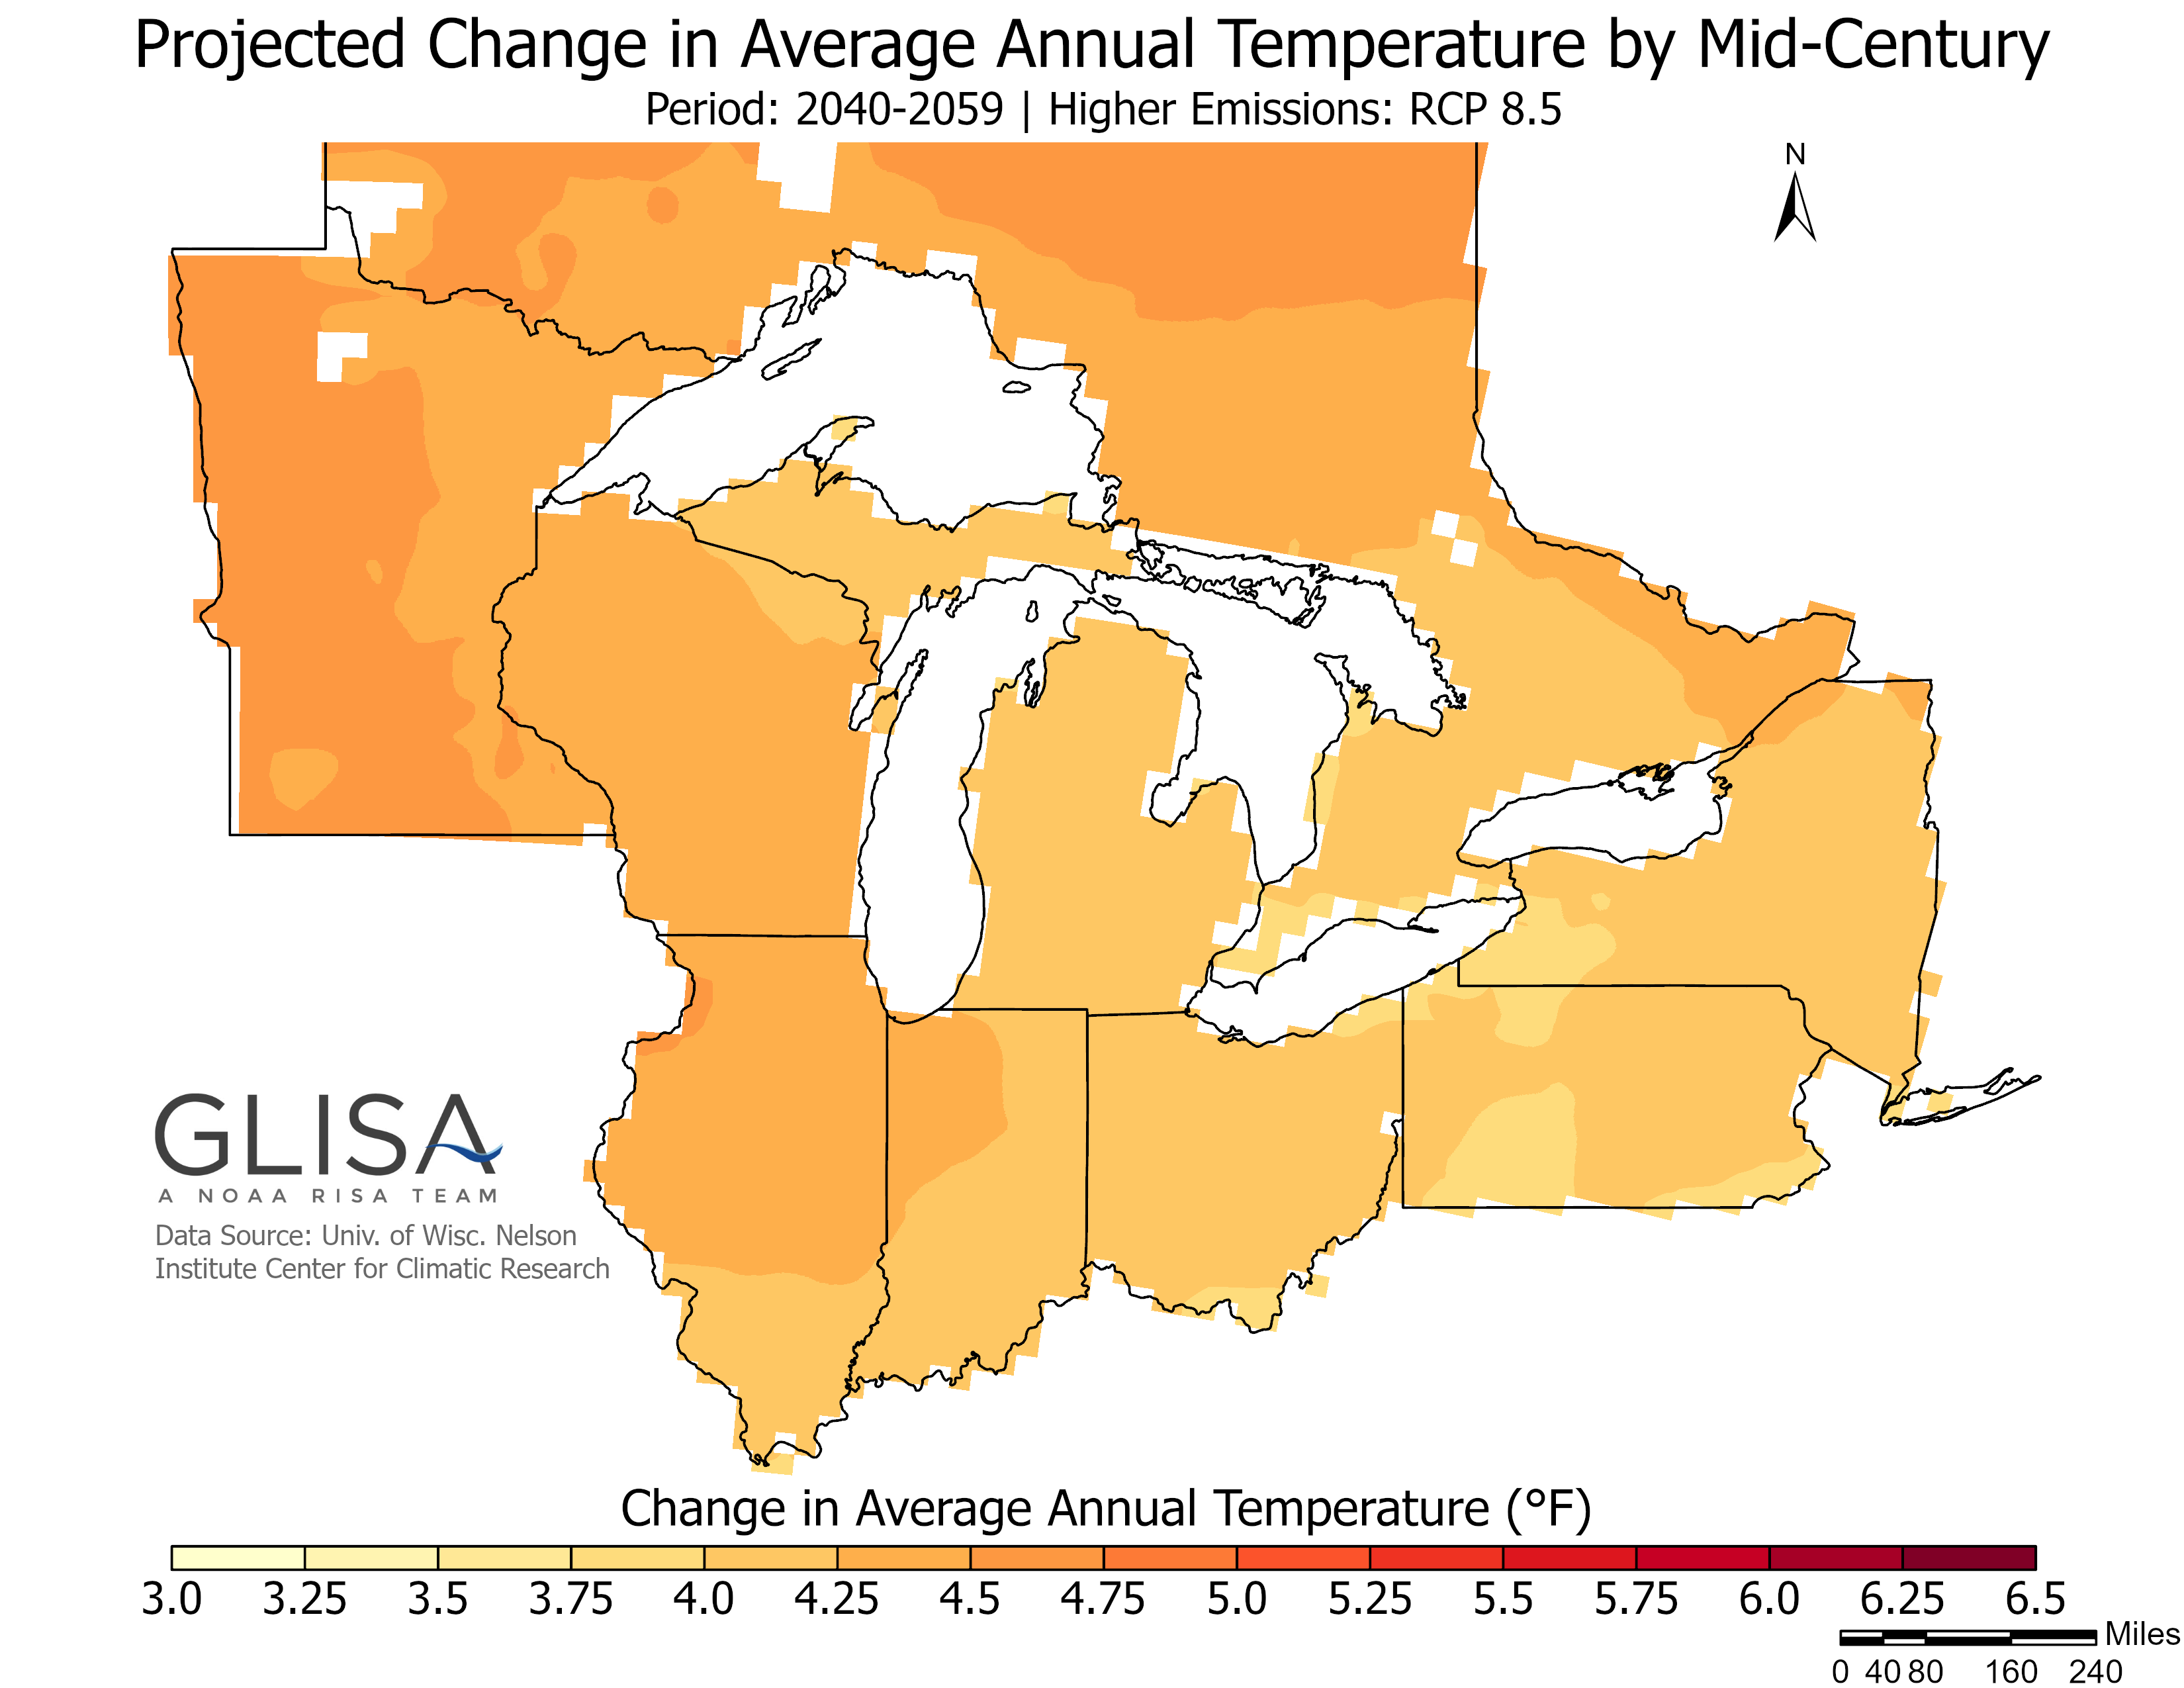
Scientific Ecological Knowledge or “SEK”
Called “western” science, “academic” science, or just “Science.” Typically, this is the single source of “knowledge” that we consider.
SEK is long term quantitative evidence of change in environmental variables (temperature, precip, drought, etc.) based on historic measurements and projections of future change in these variables.
Presented in charts, graphs, or maps. Sources include the Wisconsin Initiative on Climate Change Impacts and GLISA Great Lakes Assessments
SEK by itself lacks a relationship to what people value so it may not resonate with them.
https://wicci.wisc.edu/
https://glisa.umich.edu/great-lakes-regional-climate-change-maps/

Slide 7
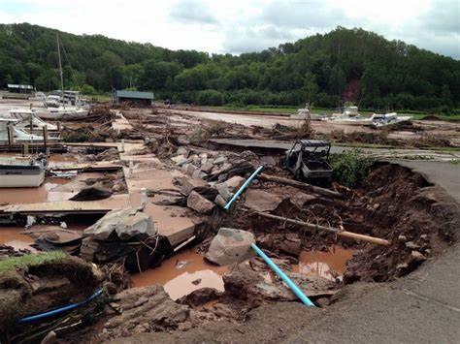
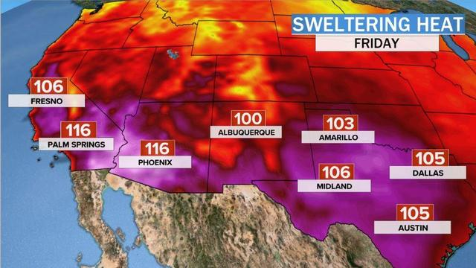
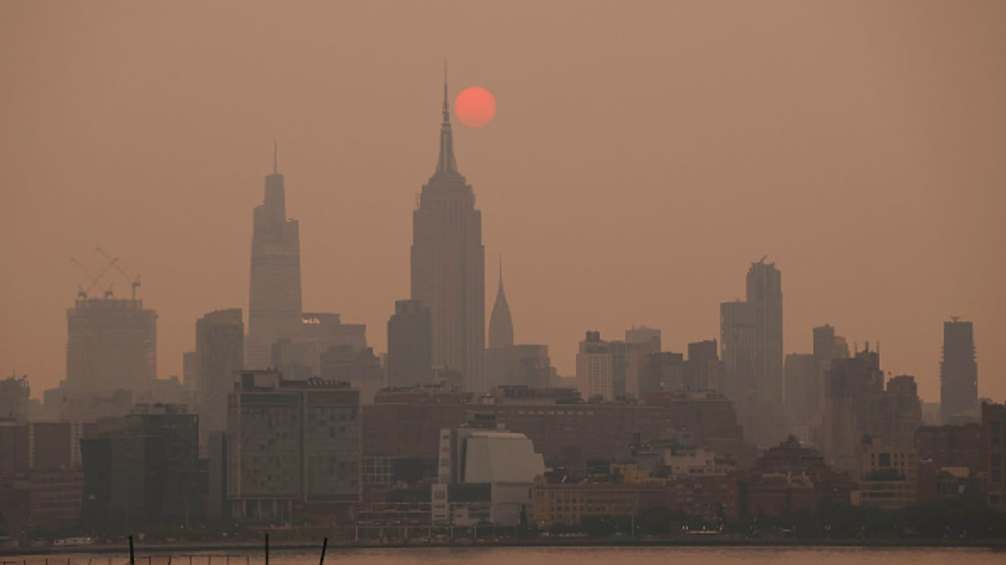
Place-Based or Local Ecological Knowledge
Qualitative knowledge based on short term observations of change in environmental variables.
Place-based Knowledge is based on observations we are seeing.
Research has found that “place-based knowledge is as effective or more effective than simply using SEK for increasing climate awareness”…. because relates to what learners are experiencing in their own “backyards.” (“The Psychology of Climate Change Communication”, Columbia University 2009)
What “place-based” evidence of climate change are you observing?

Slide 8
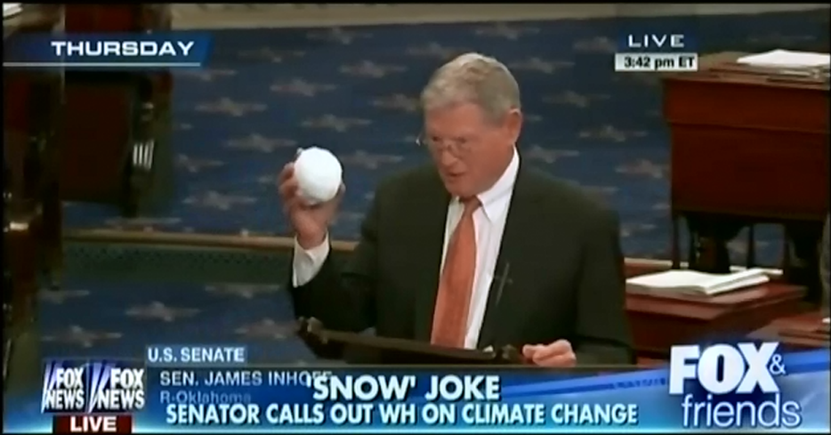
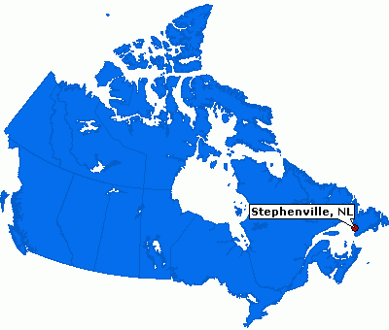
The Problem with Place-Based Knowledge
Is it Weather Variability or Climate Change?
Caution! Short term observations we see in our cultures may not be reliable indicators of climate change
Survey results in research conducted in Stephensville Canada showed that residents believed regional climate change was happening, but it was not clear whether they could tell the difference between weather variability and actual climate change.
Finnis, J., Sarkar, A., Stoddart, M. 2015. Bridging science and community knowledge? The complicating role of natural variability in perceptions of climate change. Global Environmental Change 32: 1-10.

Slide 9
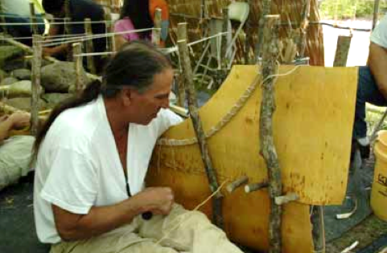
Traditional Ecological Knowledge or “TEK”
Called Tribal Ecological Knowledge, Indigenous Science, Indigenous Knowledge.
Long-term qualitative evidence based on generational experience with the environment and beings.
Knowledge embedded in indigenous culture and language.
Marin DeFoe-Red Cliff Tribal elder making a birchbark jiiman (canoe)

Slide 10
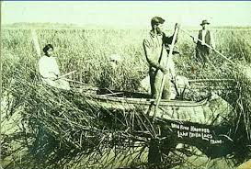
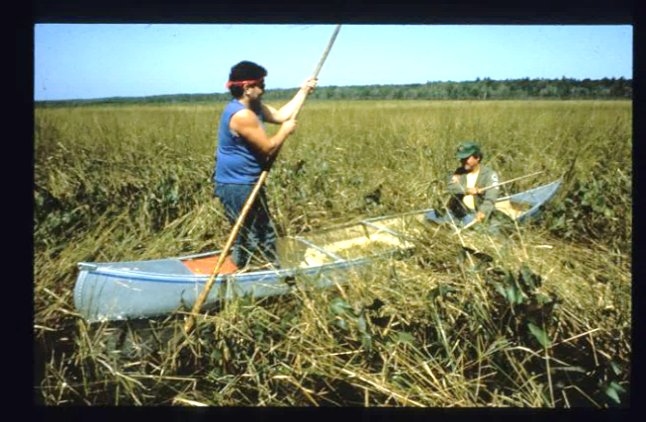
Changes being observed by indigenous people today
are based on generations of experience with beings and the habitats who support their lifeways
Wild rice harvesting (ca. 1900)
Wild rice harvesting today
Because TEK is based on long-term continued relationship with the environment, it can provide a “baseline” for evaluating place-based evidence of climate change beyond weather variability-- for all cultures!

Slide 11
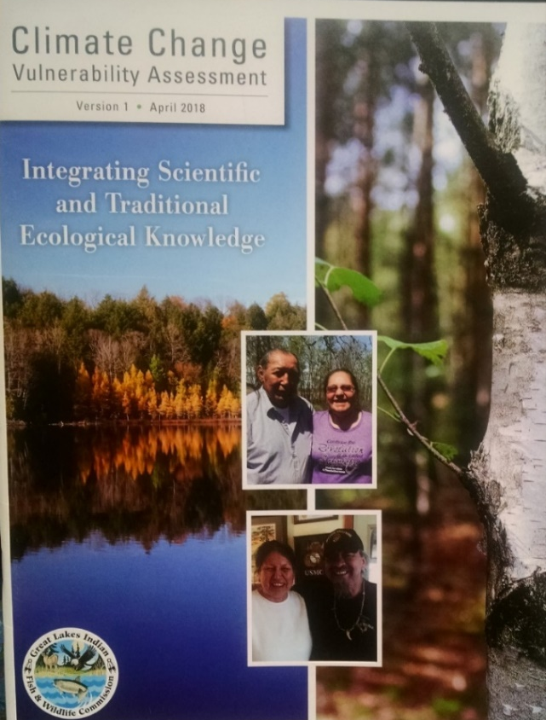
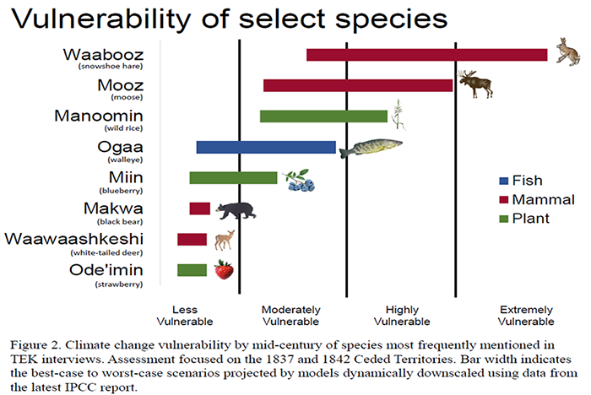
Where Can We Find Traditional Ecological Knowledge?
Great Lakes Indian Fish and Wildlife Commission’s
Climate Change Vulnerability Assessment-Edition 1 & 2
https://glifwc.org/ClimateChange/
Elders, Knowledge Keepers, Language Speakers in your community

Slide 12
TEK
Place-based
Knowledge
SEK
Weaving these knowledges together is more effective for increasing climate awareness than using any one of them separately.
The G-WOW Model weaves TEK, place-based knowledge and SEK together,
to build awareness of how climate change is affecting the
sustainability of beings and habitats
who support lifeways we value
to promote climate action.

Slide 13
Diagram of how the “G-WOW” Model Integrates TEK, Place-based, and SEK
Being/Habitat
What being and/or habitat conditions are needed to support this activity?
TEK, Place-Based, SEK
Activity
Start with an activity
a person values
How is this activity, being or the habitat it needs changing based on
TEK evidence?
How is this activity, being or the habitat it needs changing based on
place-based evidence?
How are climate variables critical to supporting these habitat conditions projected to change based on SEK evidence?
Makes climate change relevant to what a person values so the message “sticks”
A cross cultural way to teach & communicate about climate change
Adaptable to all cultures and locations, a flexible model

Slide 14
Examples of applying the G-WOW Model

Slide 15
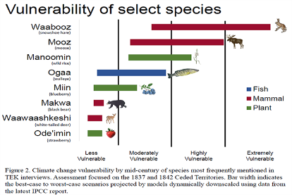
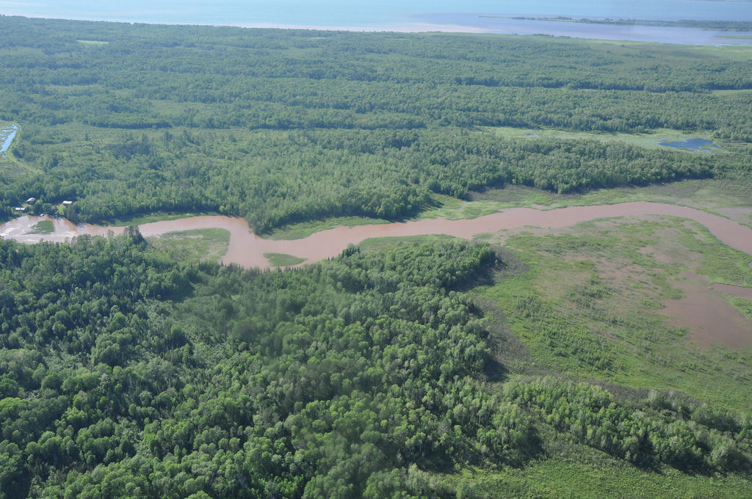
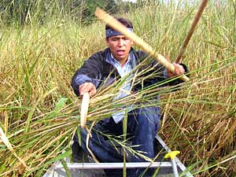
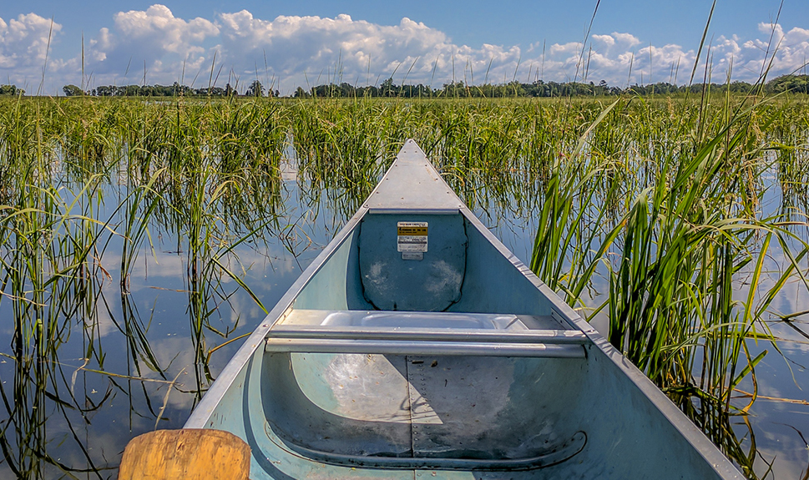
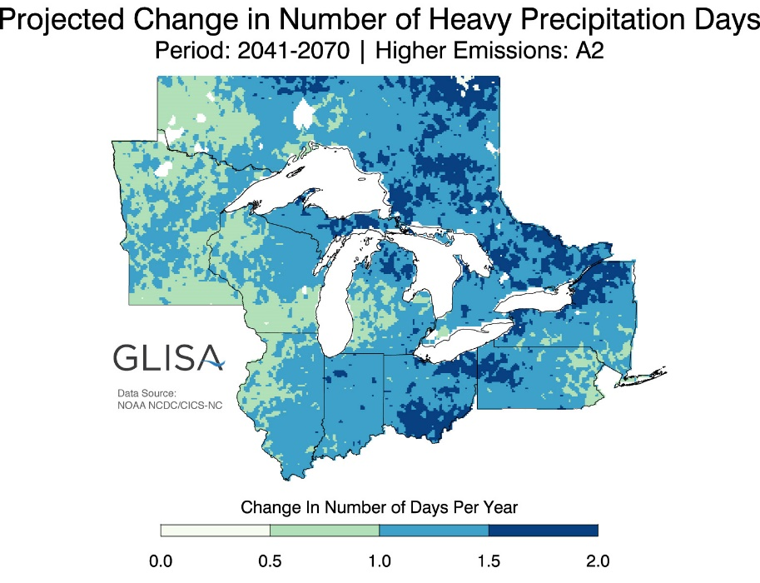
Activity
Being/Habitat
TEK, Place-based, SEK Evidence
Wild Rice Harvesting
Increased flooding of tribal wild rice beds
Wild rice (Manoomin) requires shallow water, moderate water level changes, cool growing season
How is climate change affecting the sustainability of wild rice and cultural practices that rely on it?

Slide 16
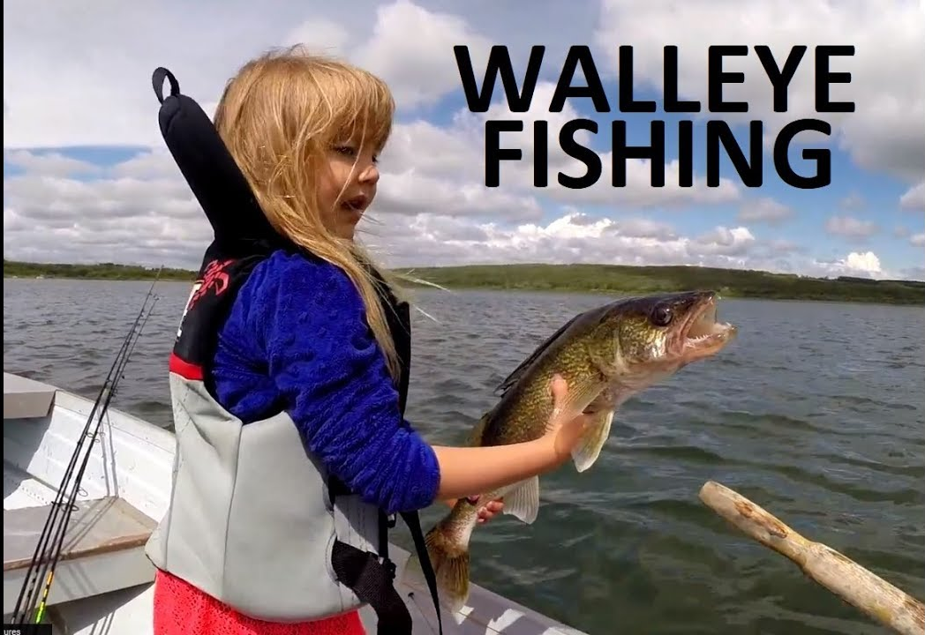
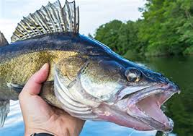
Activity
Being
TEK, Place-based, SEK Evidence
Requires cool water habitats
Observed increase in bass (red) vs. walleye (green) in WI lakes
“As water temperatures get warmer, many (Wisconsin) lakes that currently can support natural walleye reproduction are unlikely to continue to have the thermal habitat conditions to do so.” USGS report

Slide 17
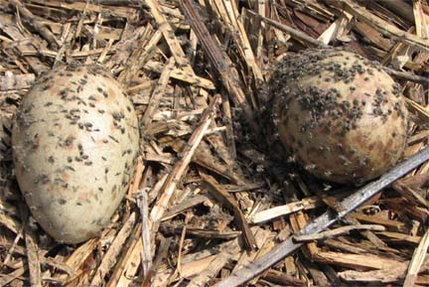
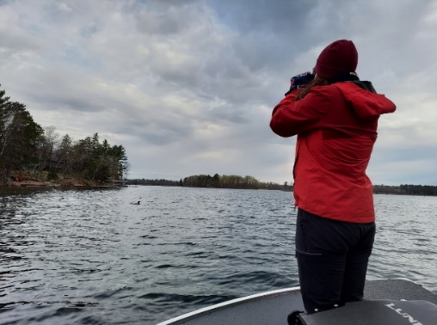
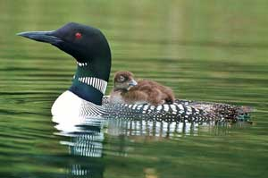
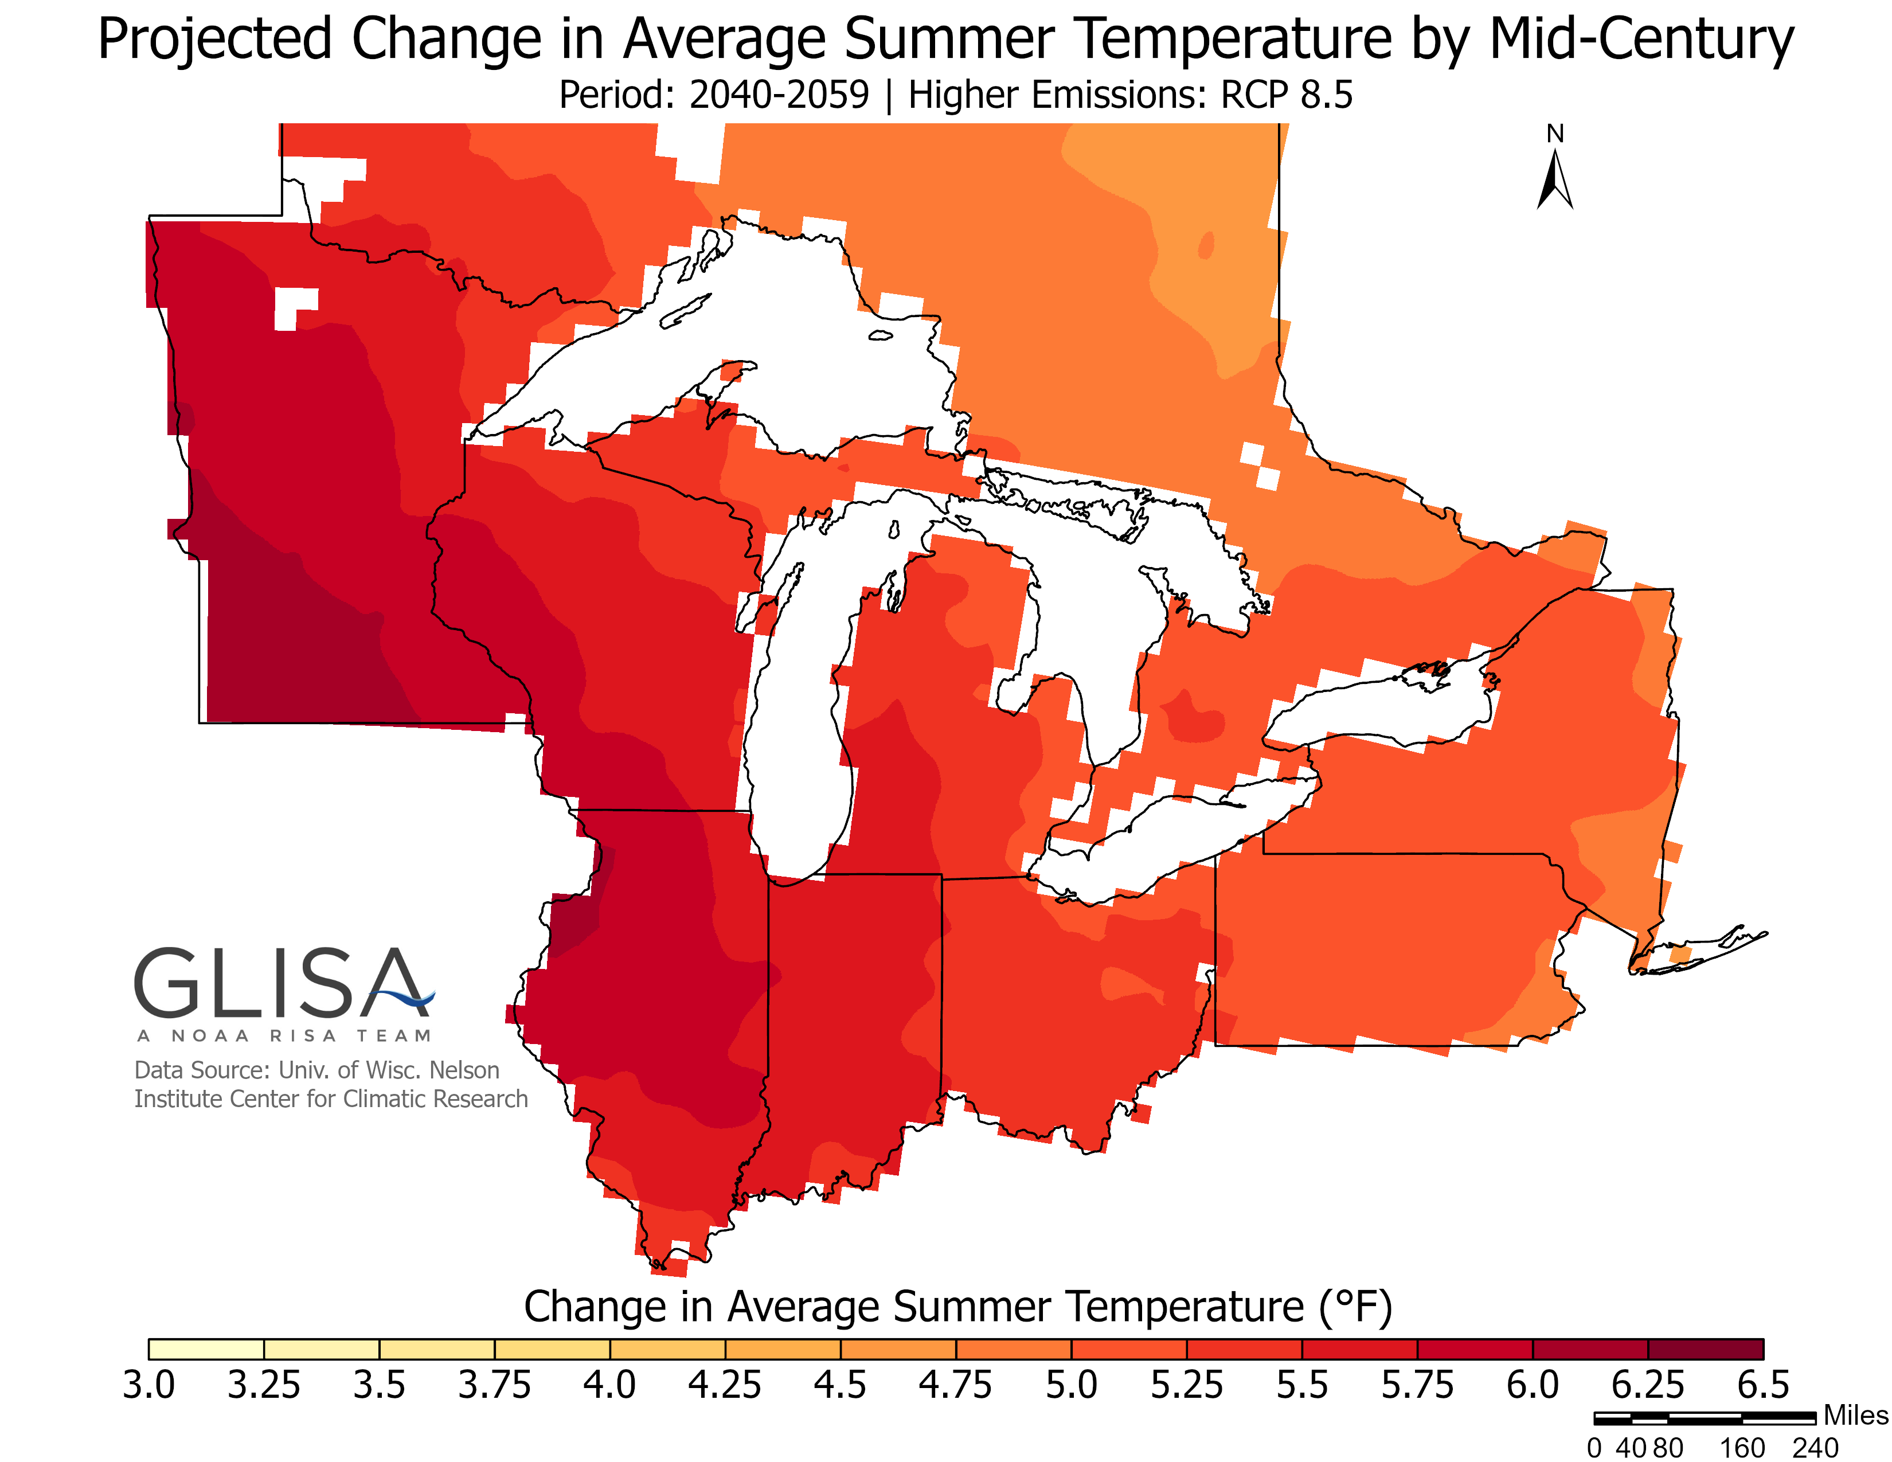
Activity
Being/Habitat
TEK, Place-based, SEK Evidence
Watching Loons
Requires shoreline nesting sites with stable to moderate water level fluctuations. Warm temperatures increase black fly predation on chicks.
“It looks all but certain that Minnesota will lose its iconic loons in summer by the end of the century.”- Audubon climate model

Slide 18
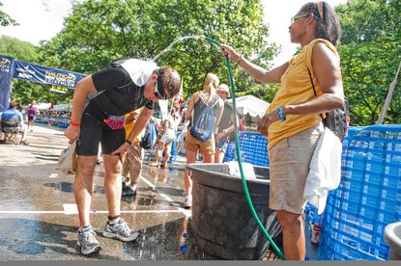
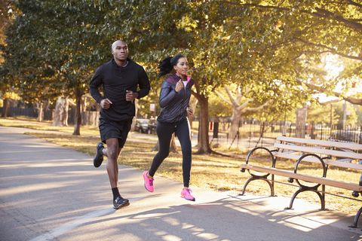
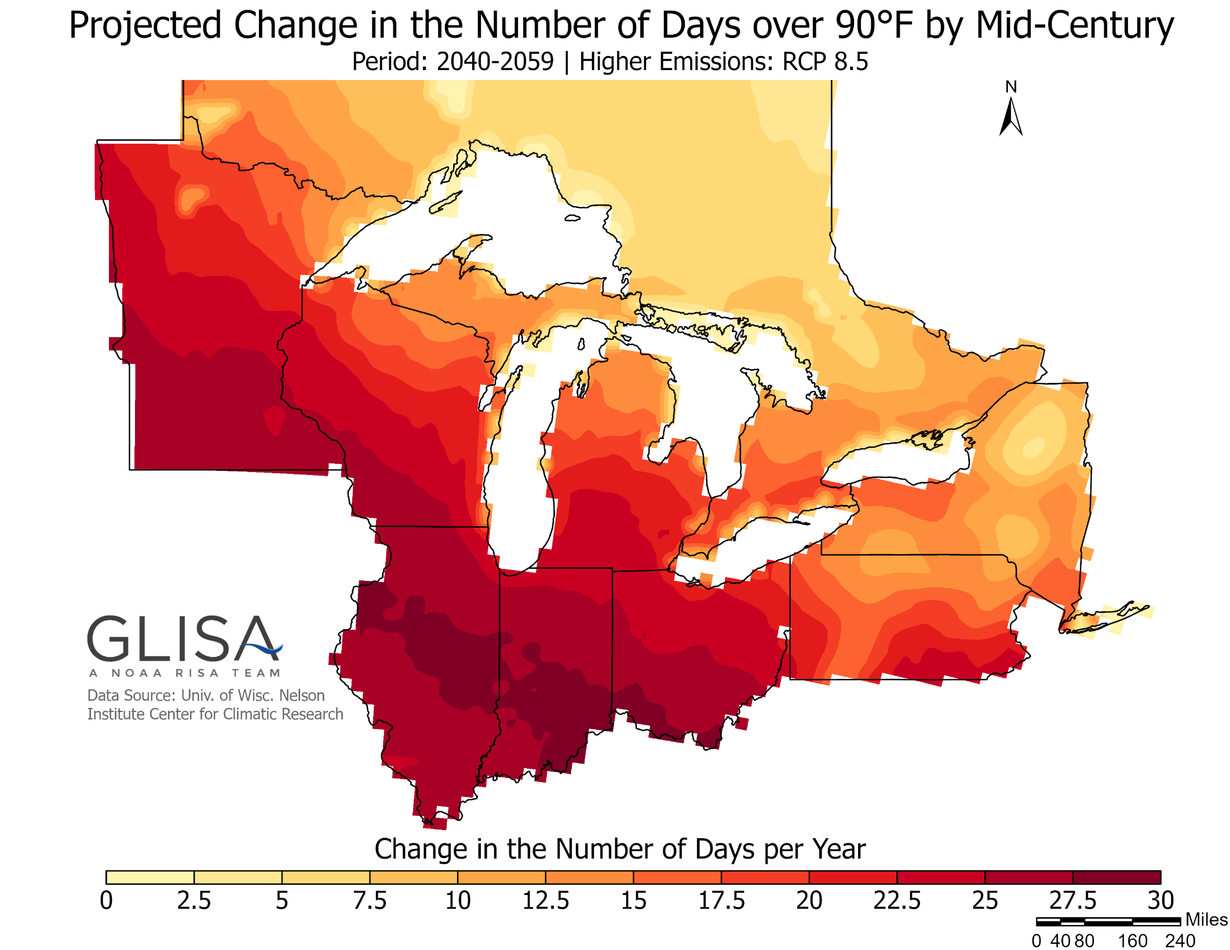
Activity
“Habitat”
Place-based and SEK Evidence
(no TEK applicable)
Ideal temperatures for running are between 44° F and 59° F (°F)
How could climate change affect summer recreation and athletic events?
This example shows how the G-WOW model can be applied using only place-based and SEK evidence.

Slide 19
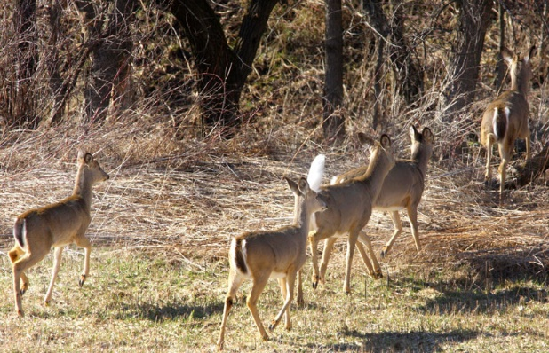
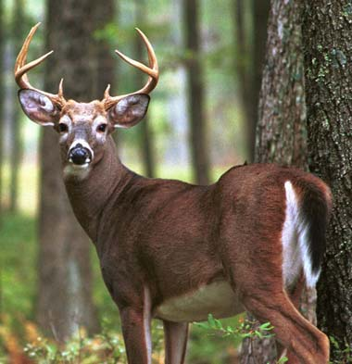
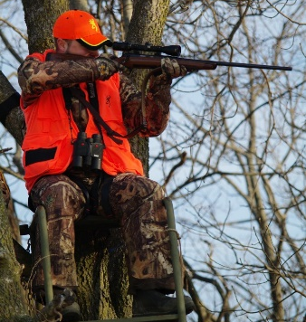
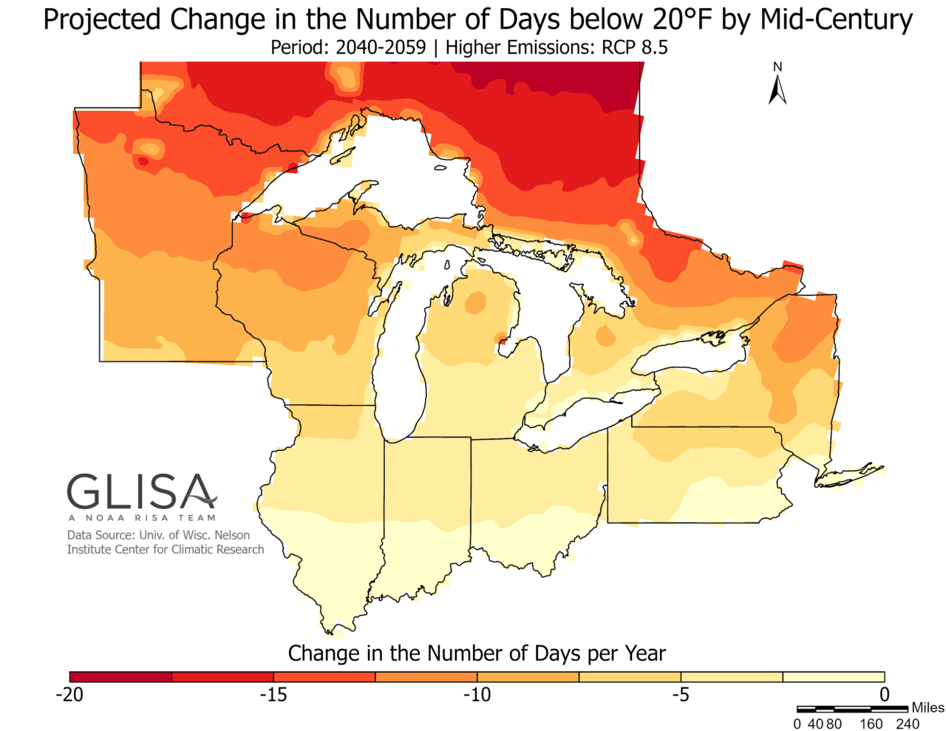
Activity
Being/Habitat
TEK, Place-based, SEK Evidence
Deer Hunting
White tail deer (Waawaashkeshi) are highly adaptable to a variety of habitats. Warmer winters reduce energy loss and stress
How will climate change affect the sustainability of this being?
Are there any limiting factors that could affect it?

Slide 20
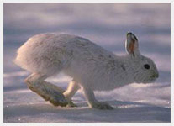
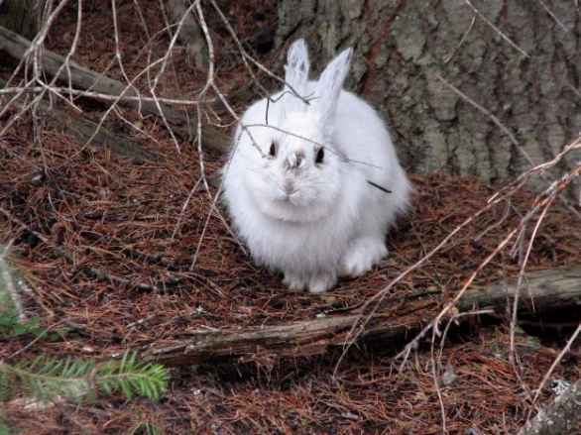
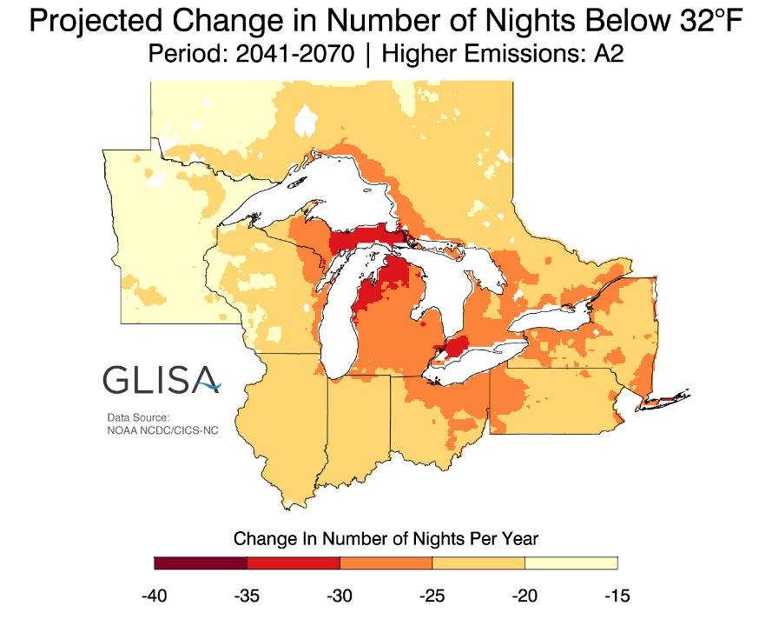
Being
TEK, Place-based, SEK Evidence
Phenology Miss-Match
Phenology Miss-Match
Wabooz, the Snowshoe hare requires snowy habitats for winter camouflage
Fewer nights below 32 ºF means less snow, but Wabooz still turns white in winter. What is Wabooz teaching us about other beings and activities rely on snow and cold?

Slide 21
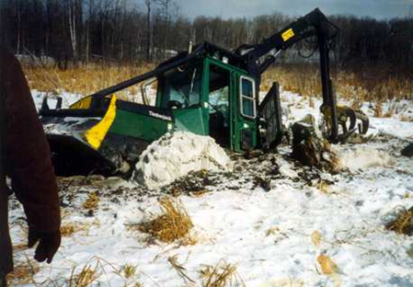
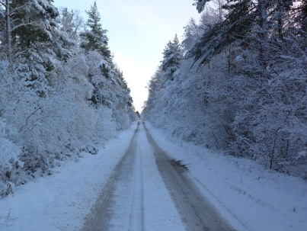
“Habitat”
Place-based and SEK Evidence
Activity
Winter logging
frozen roads
Logging equipment breaking through unfrozen ground
Requires temps below 32ºF
Like Wabooz, loggers need cold winter temperatures.
There is projected to be 20+ fewer nights below 32 ºF by mid-century.
Fewer cold nights = Less frozen ground = Reduced transport of logs to market = Less $$$

Slide 22
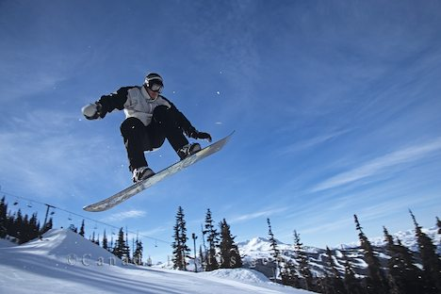
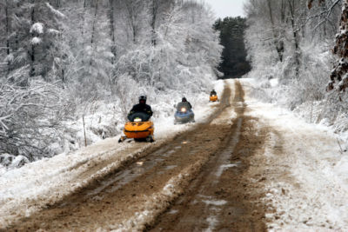
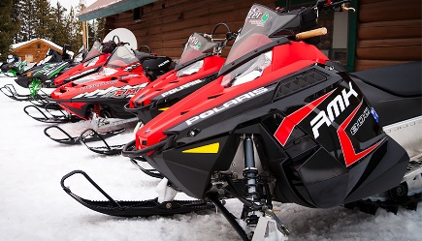
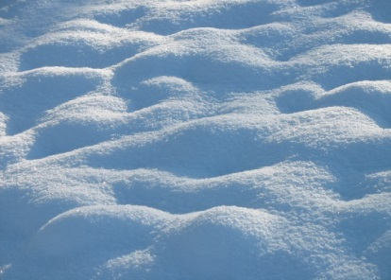
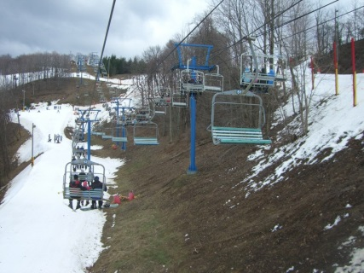
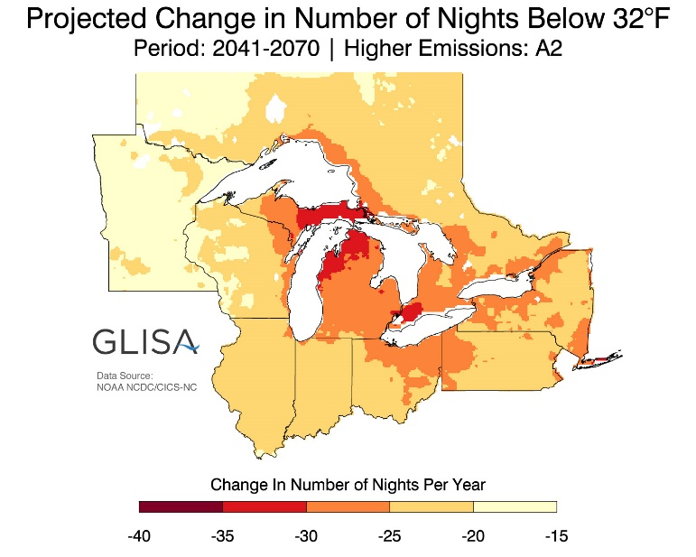
Activity
“Habitat”
Place-based- SEK Evidence
Winter recreation
Requires temps below 32ºF
Climate change is teaching us that
we are all connected

Slide 23
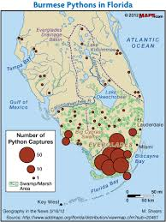
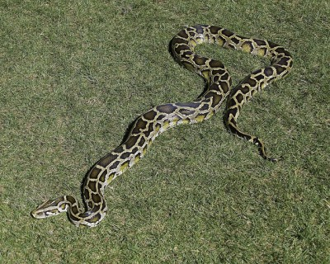
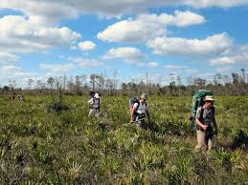
The G-WOW Model is transferable to other cultures and locations
Activity
Being/Habitat
Place-based and SEK Evidence
Hiking in the Everglades
Large circles = 50 or more pythons captured
Increase in 95+-degree day/year, 2041-2070.
Invasive Burmese python:
requires very warm, moist “tropical” habitats
What does a changing climate mean for the sustainability of this invasive species? How could this affect recreation, nature-based tourism economies?

Slide 24
Consider how this methodology could be applied to build climate awareness based on a variety of activities & lifeways

Slide 25
The G-WOW model builds awareness…
(the set up)
Do culture and science agree? Is climate change affecting the sustainability of habitats and/or beings that support activities you value?
What do these changes mean for your community, environment, economy?
… with the goal of provoking people to take ACTION
(the spike)

Slide 26
The BIG “SO WHAT”… WHAT CAN WE DO?
The G-WOW website provides ideas and templates for taking action and a blog where projects and results can be shared
Mitigation Adaptation
Putting on the brakes to avoid an impact
Lessening the impact
Notes:
Mitigation is like putting on the brakes to avoid hitting the wall. Adaptation is like the air bag that deploys after we’ve hit the wall to lessen the impact. Both strategies can help reduce negative impacts!

Slide 27
Communication is ACTION
Make It Personal…..use the G-WOW method. Start with place-based evidence of how climate change is affecting an activity, place or being that the person values so the message “sticks.” Weave in TEK and SEK to reveal other sources of climate change evidence.
Listen to their observations … tell your climate story. The more we communicate with others about climate change, the more this issue moves to the forefront which will support broader action.
Encourage them to take action.
Highlight opportunities to take climate action that resonate with the person’s interests such as increasing energy efficiency, saving money, reducing reduction of dependence on foreign energy. Focusing on “doom” can cause climate fatalism, resulting in inaction.

Slide 28
Is the G-WOW methodology effective in teaching about climate change?
Evaluation of 2015 educators using this approach agree or strongly agree:
An increase in personal climate literacy and teaching skills
Being more confident in teaching about climate change
The model is transferable to their student populations despite location
Source: Patty Carpenter, 2016 UMD Master Degree Thesis:
“G-WOW Changing Climate, Changing Culture Professional Development's Influence on Classroom Teachers”
Evaluation of 2019 educators:
100% very likely to extremely likely to incorporate place-based evidence in their climate outreach
92% increased their confidence in teaching about climate change
100% were likely or extremely like to use this training to help others adapt climate resiliency behaviors
Source: Climate Strong! professional development institute evaluation, 2019

Slide 29
G-WOW Website
A ready-to-use climate and culture curriculum, plus supporting resources
www.g-wow.org
Outreach Resources
Ojibwe Lifeways Units
Four seasonal units, and a water unit for investigating place-based & TEK-based evidence of climate impacts on Ojibwe lifeways and how to apply this model to your culture.
Talking Circle
Sharing climate action
stories and resources
What Can We Do?
Creating climate action projects
Investigate the Science
Integration of SEK-based climate research to evaluate whether culture and science agree

Slide 30
- Joe Rose, Bad River Tribal Elder

Slide 31
Chi Miigwech (A Big Thank You) to these G-WOW Project Partners

Slide 32
Please contact me if you have any questions or suggestions
Chi Miigwech !
(a big thank-you!)
Cathy “Cat” Techtmann-Environmental Outreach State Specialist
University of Wisconsin-Madison Division of Extension
cathy.techtmann@wisc.edu

